Slide 1
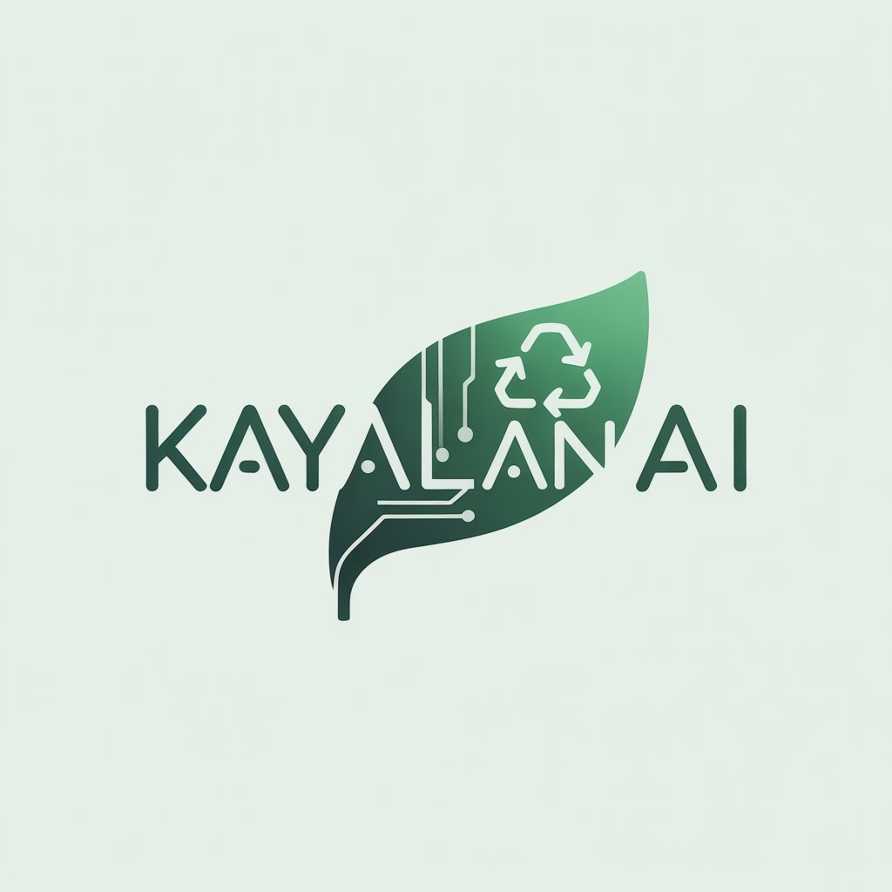
KAYALAN AI – Mixed Reality Scrap Waste Shop
Tagline: A Digital & Clean Scrap Management System
Presented by: Hema Malini SP
Event: Buildathon 2025
Date: 15TH –16TH November
Venue: AMET UNIVERSITY

Slide 2
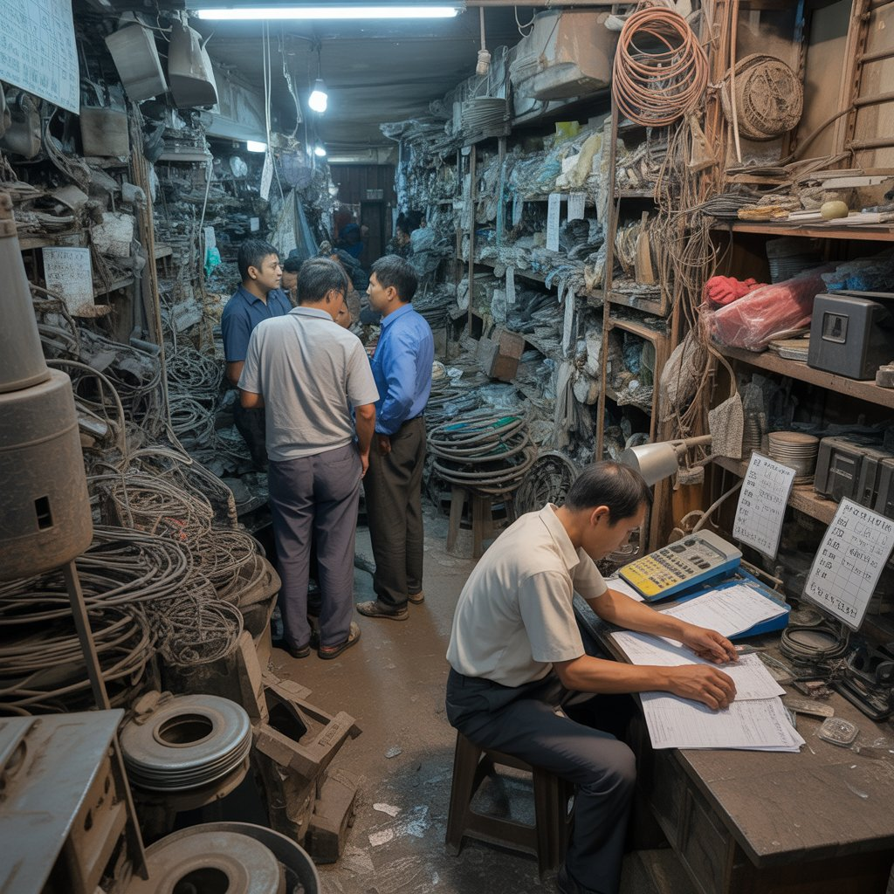
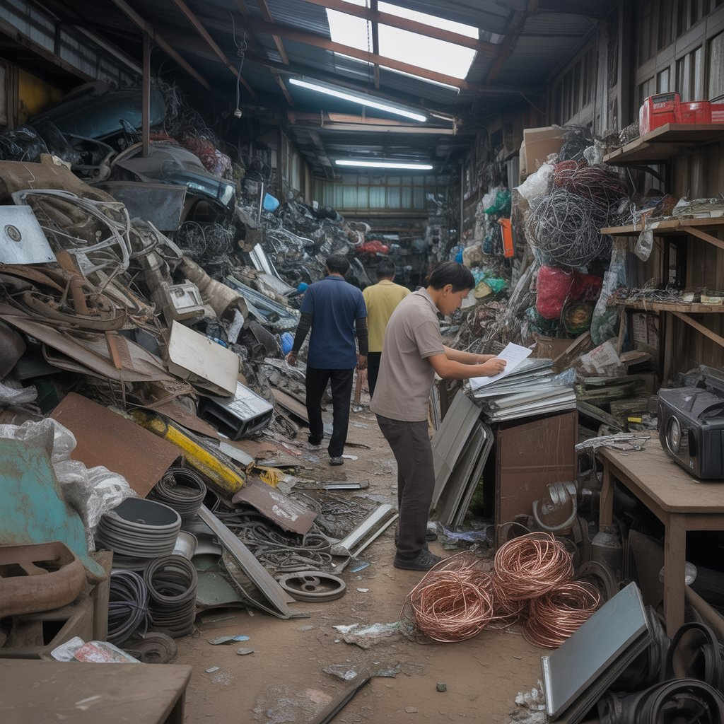
Problem Statement
• Scrap shops are unorganized
• No price transparency
• Manual weighing errors
• Poor hygiene
• No digital tracking

Slide 3
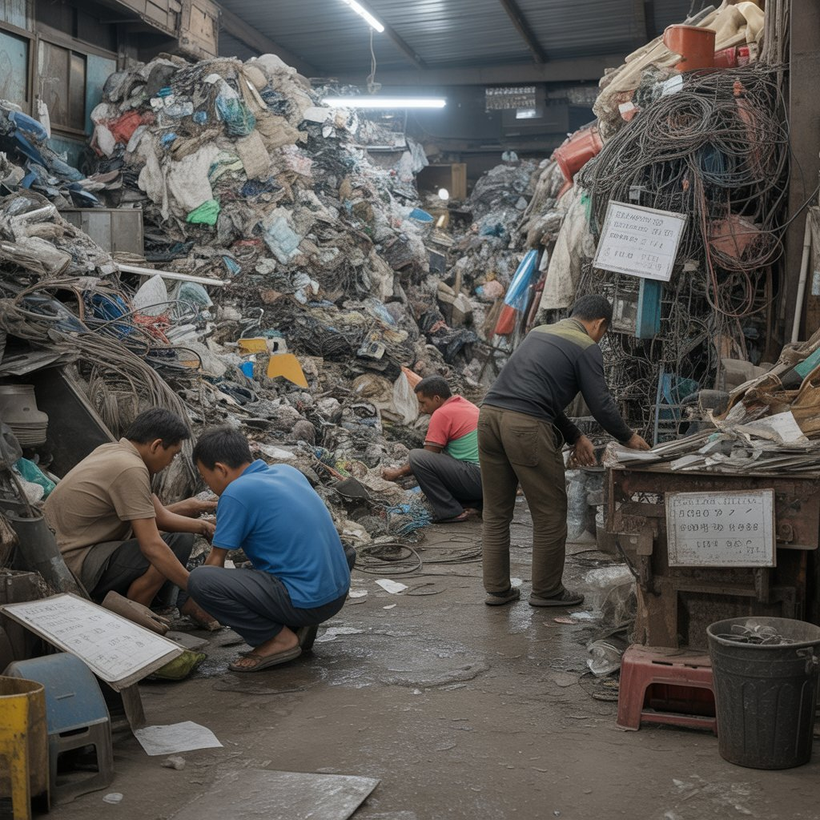
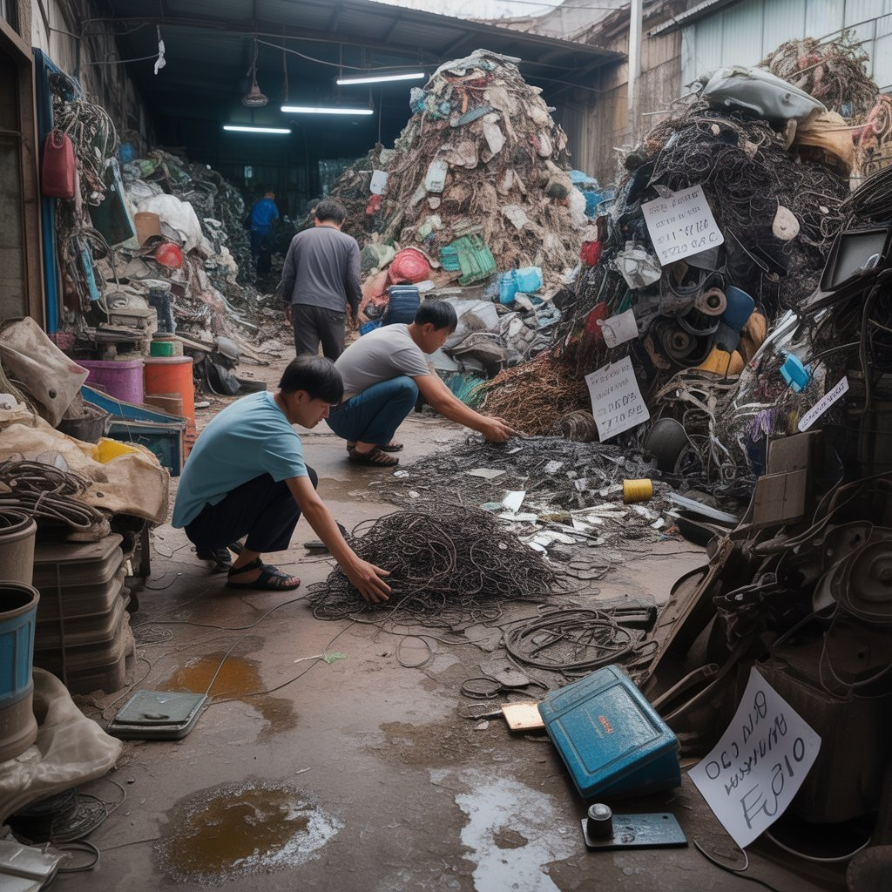
Existing Drawbacks
• No digital system
• No inventory management
• No customer experience
• No standard pricing
• Low trust level

Slide 4
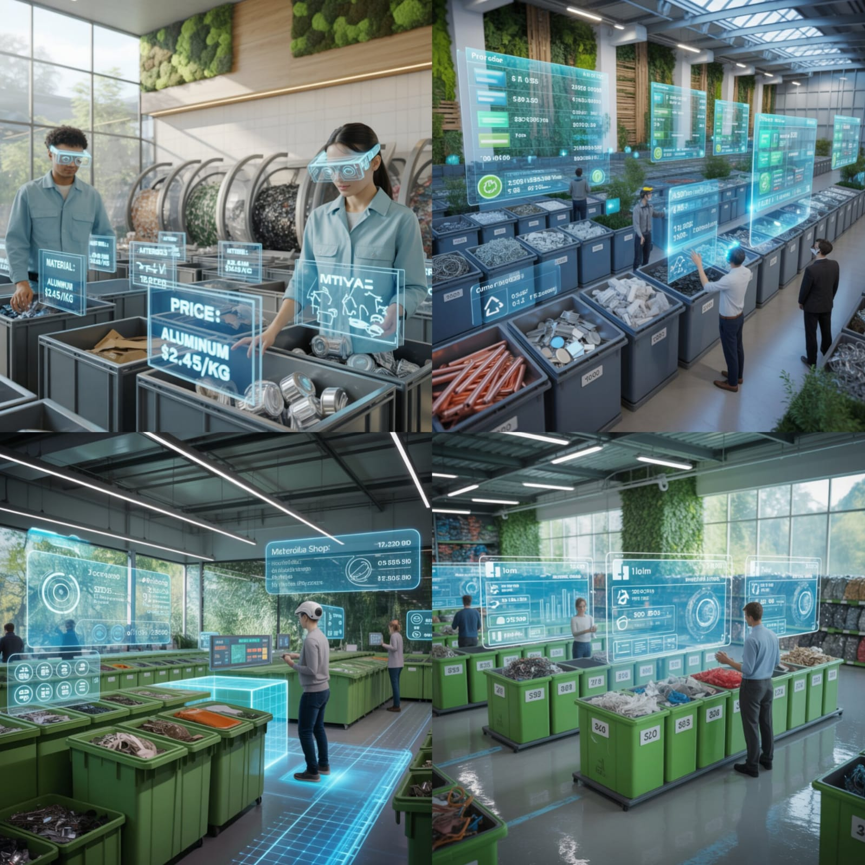
Proposed solution
Mixed Reality-based Scrap Waste Shop:
Virtual shop experience
3D visualization of scrap items
Real-time price estimation
MR-based sorting & weighing

Slide 5
Project Workflow
• User enters MR app
• Selects scrap item
• Views 3D model
• Sees price & material value
• Confirms selling
• Data stored in cloud

Slide 6
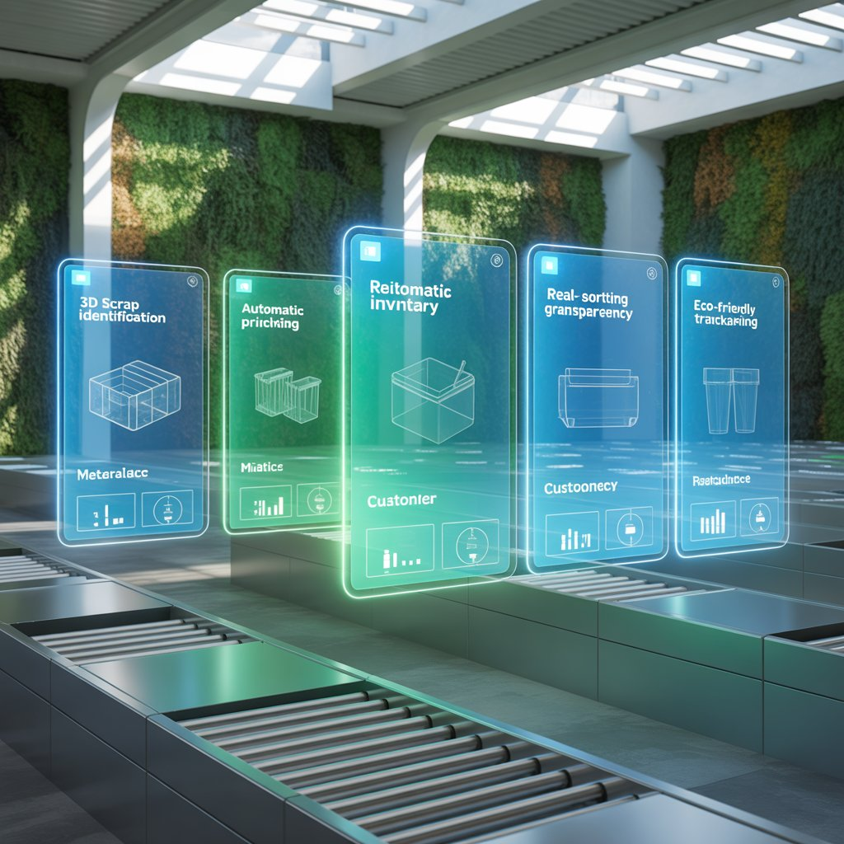
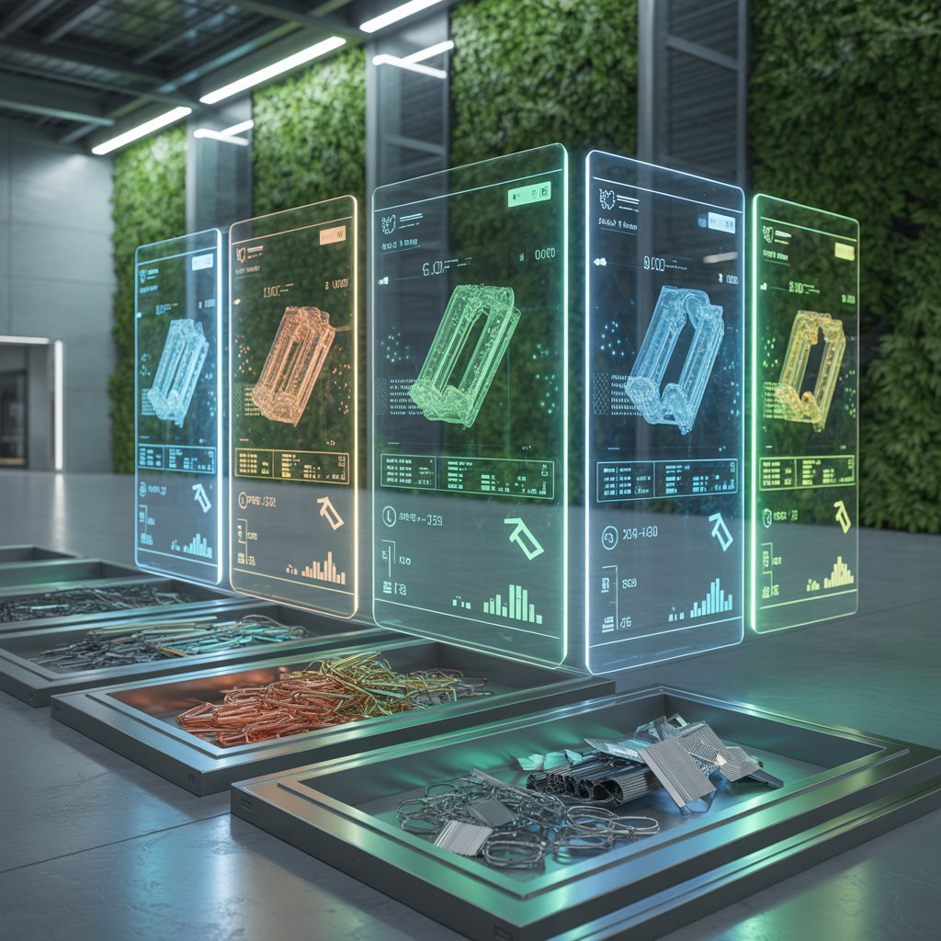
Features
• 3D models of waste items
• MR interface for scanning
• Auto price calculator
• Customer dashboard
• Eco-friendly UI theme

Slide 7
Technologies Used
• Mixed Reality: Unity/Unreal
• 3D Models: Blender
• Backend: Firebase / Node.js
• Frontend: MR headset / Mobile AR
• Design: Nature-themed (KAYALAN)

Slide 8
Future Scope
• Automated scrap collection
• IoT-based smart bins
• AI waste detection
• Price prediction using ML
• Recycling company integration

Slide 9
Impact
• Encourages recycling
• Reduces waste
• Builds trust
• Clean digital process
• Environmental benefit

Slide 10
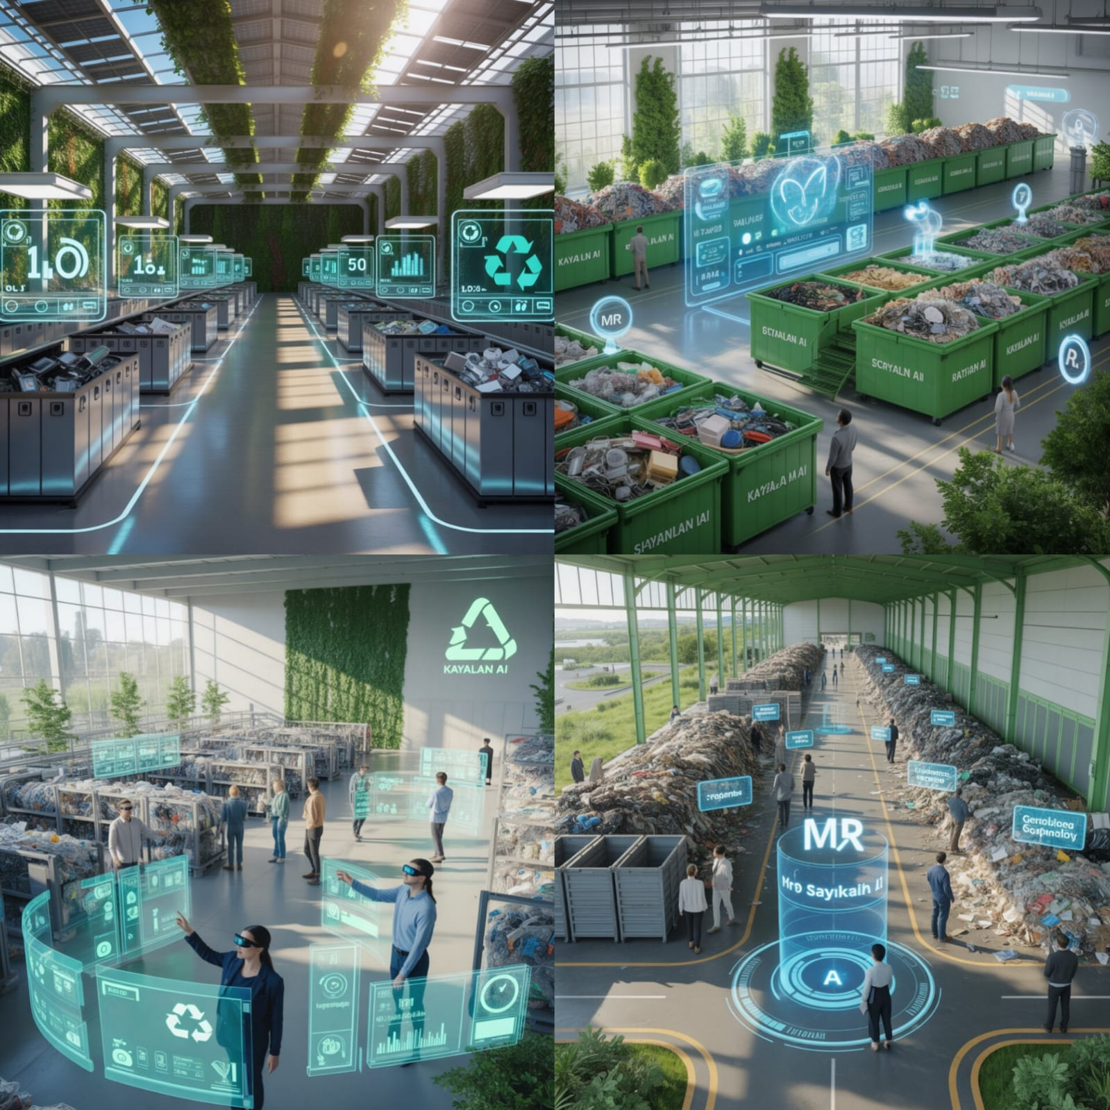
Conclusion
• MR improves scrap industry
• Digital, clean, transparent experience
• Scalable solution for future waste management

